Slide 1
CAP476:
Data Communication and Networking
Unit-II
Transmission Impairment

Slide 2
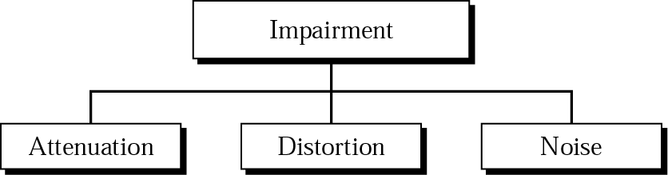
Transmission Impairment
Attenuation
Distortion
Noise

Slide 3
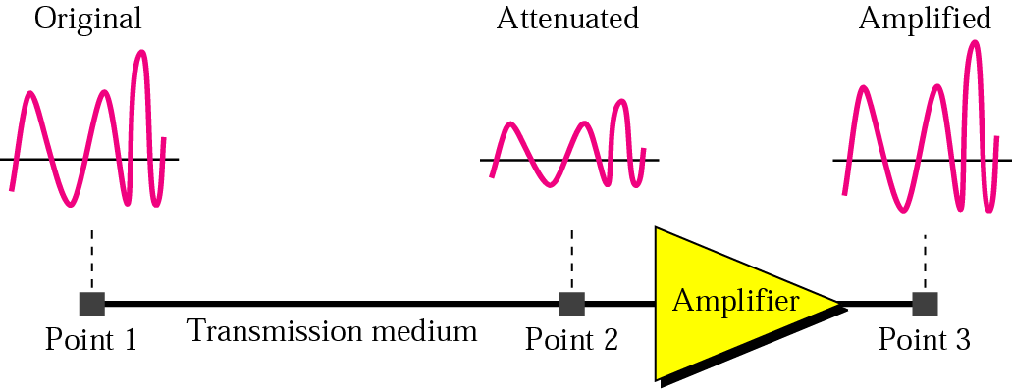
Attenuation
signal strength decreases

Slide 4
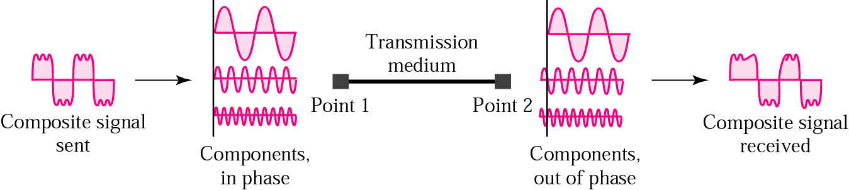
Distortion
waveform shape changes.

Slide 5
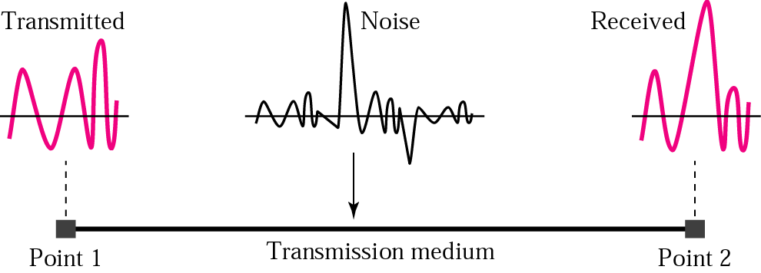
Noise
unwanted random interference

Slide 6
More About Signals
Throughput
Propagation Speed
Propagation Time
Wavelength

Slide 7
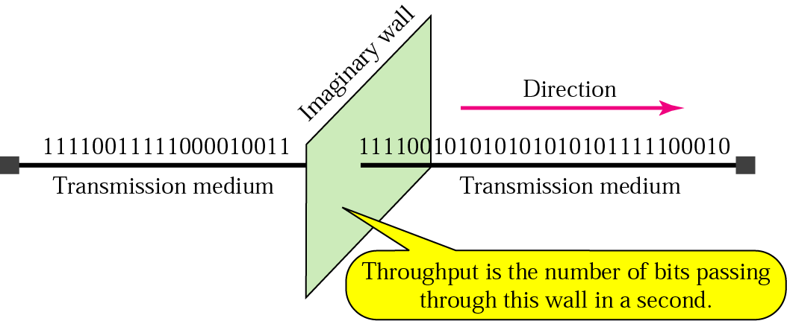
Throughput
actual delivered data rate

Slide 8
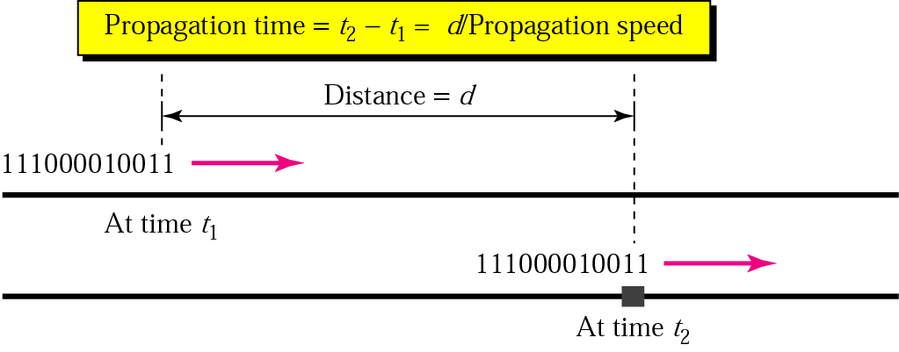
Propagation Speed and time
Propagation speed: medium-dependent velocity.
Propagation time: distance divided by speed.

Slide 9
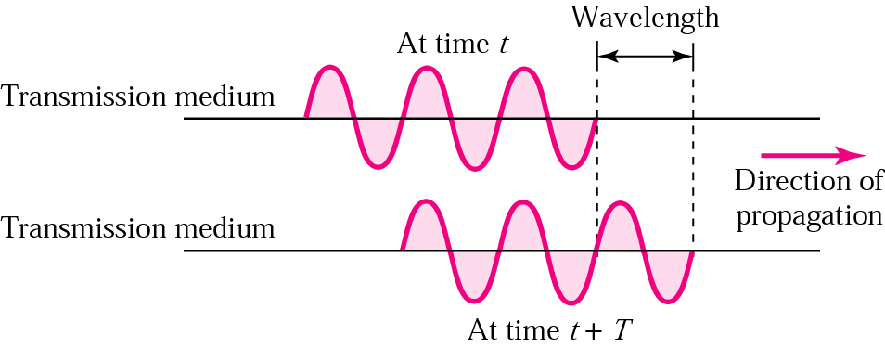
Wavelength
speed divided by frequency

Slide 10
THANK YOU

